Slide 1

Data Visualization using
D3.js
Jesús Alejandro Valdés Valdés
Philipp Müller

Slide 2
What is data visualization?
Definition data:
“facts and statistics collected together for reference or analysis.”
Definition visualization:
“(..)is any technique for creating images, diagrams, or animations to communicate a message.(...)”

Slide 3
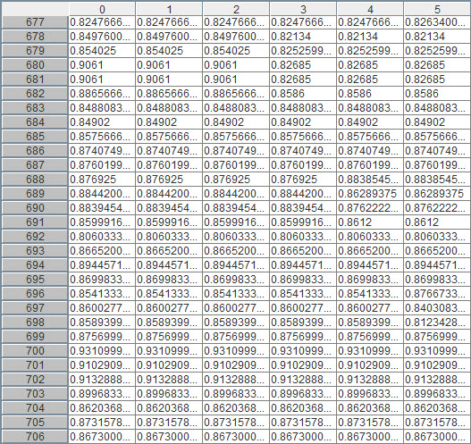
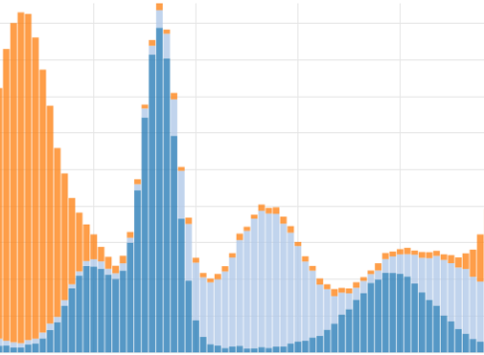
Why is it important?
VS

Slide 4

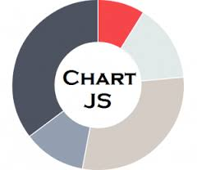

Data visualization libraries
D3.js
Raphäel.js
vis.js
Paper.js
Chart.js
Cytoscape.js
and many more...

Slide 5
How can we visualize data in a browser?
HTML elements
+Supported on any browser
-Rigid format
-Simple shapes
Canvas
+Faster for many objects (>1000)
-Undefined behaviour
-No events and callbacks per element
SVG
+Flexible
+DOM handling
+Events and callbacks
+Resolution independent
-Slower for many objects (>1000)

Slide 6

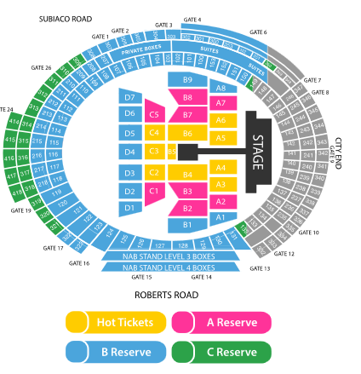
SVG
Scalable Vector Graphics
W3C
2D
Transformation and Animation
Text or drawing software

Slide 7
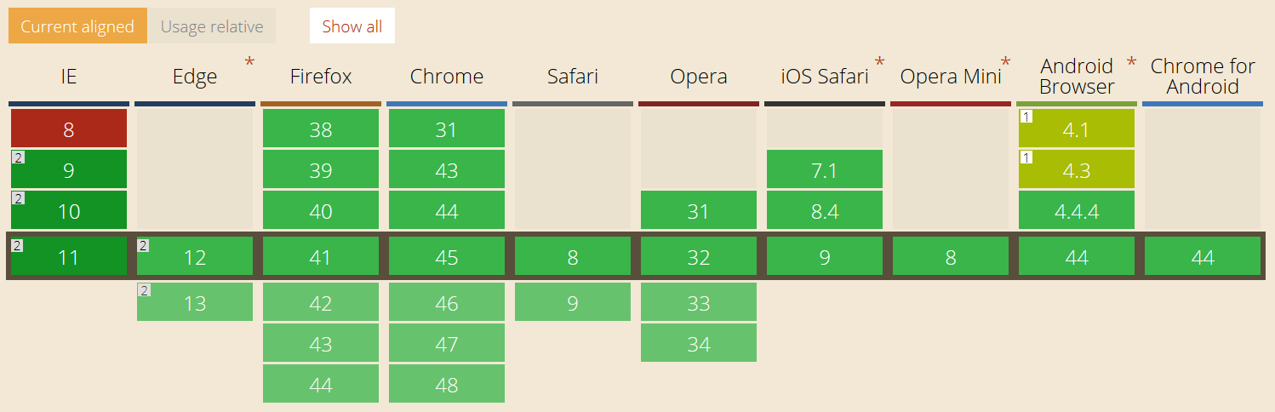
SVG - Basic support in browsers
SVG basic functionality supported in ~95%.

Slide 8

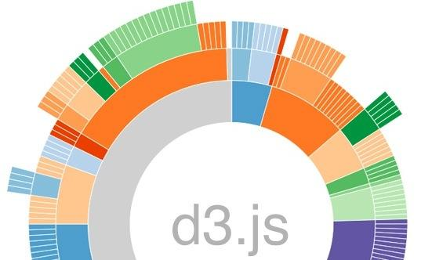
D3
Data Driven Documents.
Developed by Mike Bostock 2011 [1]
Formerly known as Protovis
DOM data binding

Slide 9
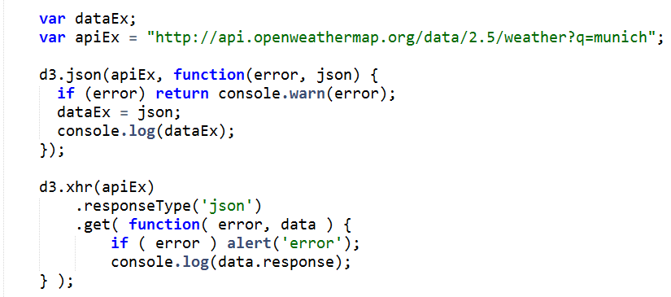
How can we get data?
d3.csv
d3.html
d3.json
d3.tsv
d3.xml
d3.xhr

Slide 10
D3 Selectors
An array of elements from the document
CSS3 selectors
Select by
tag (“div”)
class (“.class”)
id (“#id”)
attribute (“[color=red]”).
Selectors can also be...
...intersected via logical AND: ".this.that"
or unioned via logical OR: ".this, .that"

Slide 11
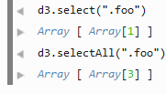
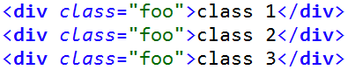
D3 Selectors
d3.select(selector): Selects the first element that matches the selector
d3.selectAll(selector): Selects all elements that match the selector

Slide 12
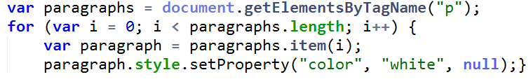

D3 Selectors - Comparison
W3C - World Wide Web Consortium
D3 (Selections)

Slide 13
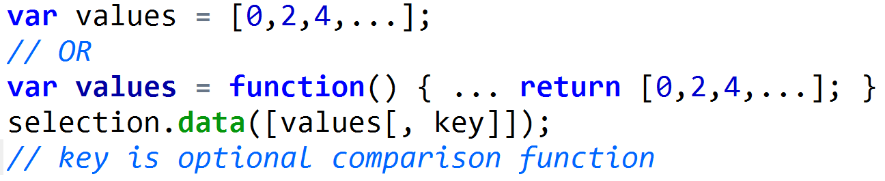
Joins
Tell D3 that the selection corresponds to data.
Base for enter, update and exit methods.
No ifs or fors needed

Slide 14
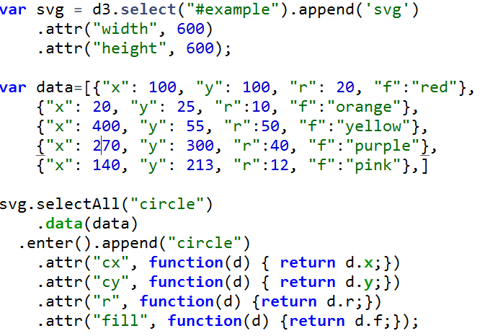
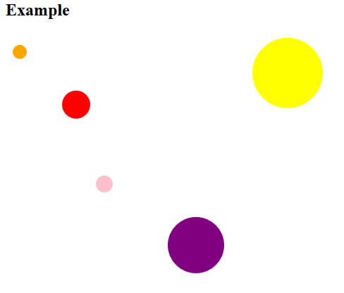
D3 - Declarative Approach
“Tell it what to do, not how to do it.”

Slide 15
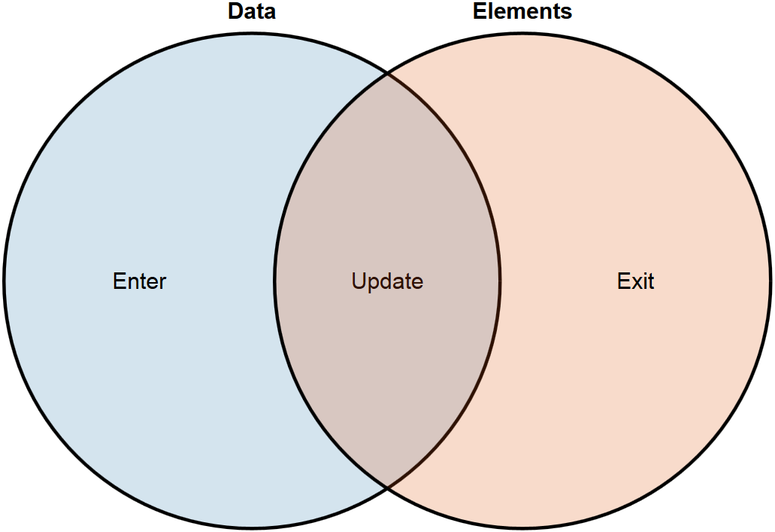
D3 - Enter, Update and Exit methods

Slide 16
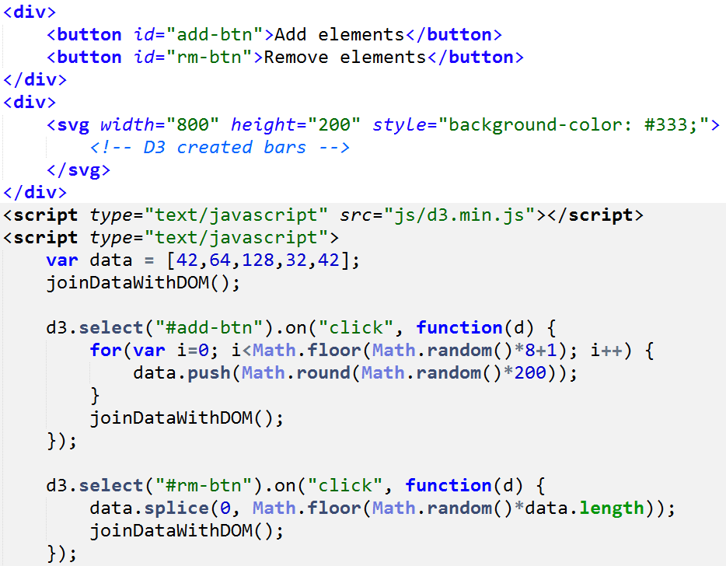
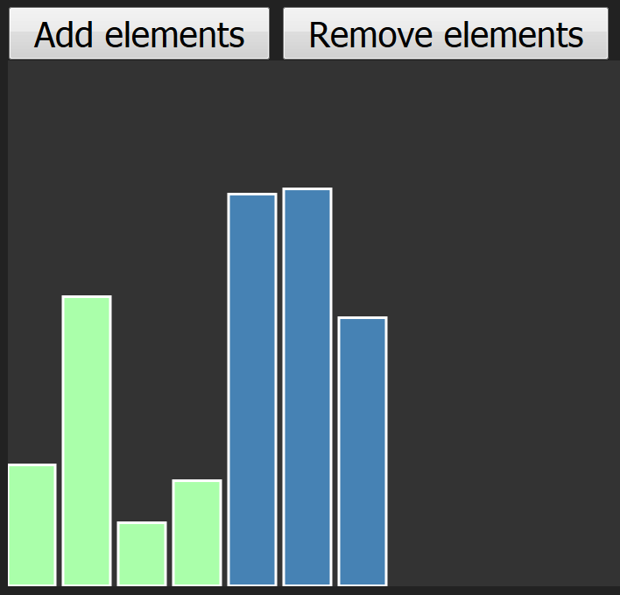
D3 - Enter, Update and Exit methods

Slide 17
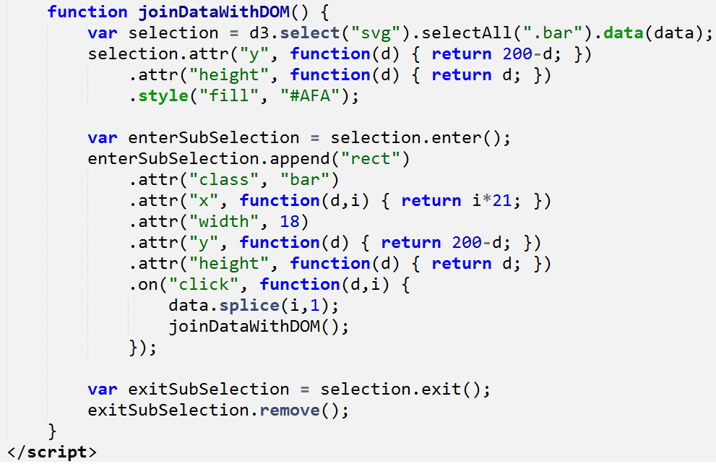
D3 - Enter, Update and Exit methods

Slide 18
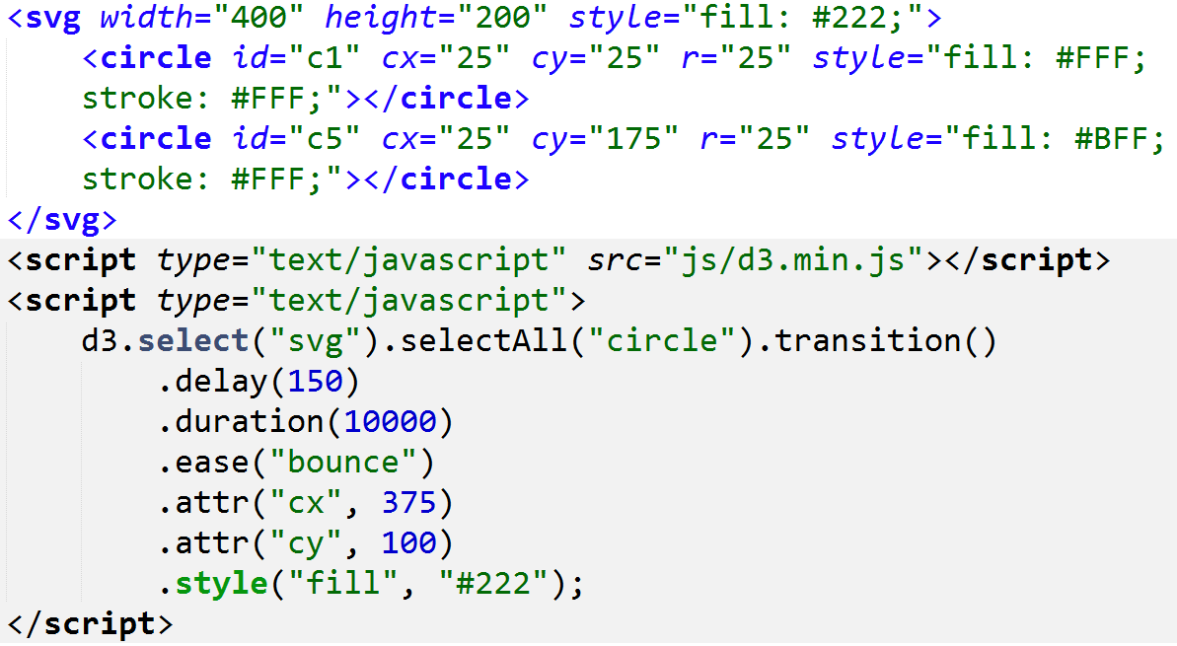
D3 - Transitions

Slide 19
D3 - Advantages and Disadvantages
Transformations & transitions | No IE8 compatibility
Fast development cycle | Steep learning curve
DOM manipulation | No own visualization methods
CSS selectors | D3 is not perfect
Creative freedom
Great community, nice tutorials

Slide 20
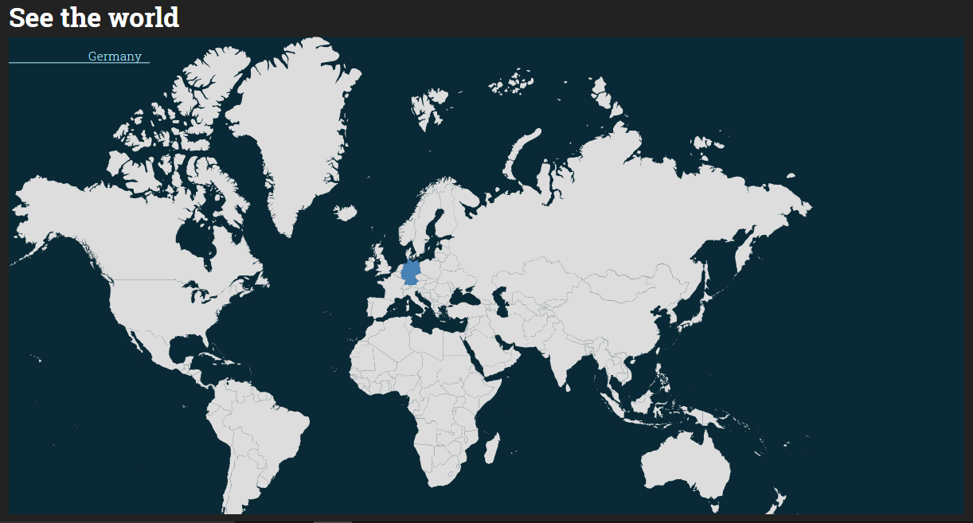
Our App

Slide 21
Performance
Cost | Entries | Functions
59.56% | 20528 | Graphics
34.72% | 11966 | Gecko
1.80% | 619 | Styles
0.86% | 298 | Input & events
performance measured in mozilla firefox version 40.0.3

Slide 22
Problems we had
Performance
many draw calls
large path data
Transitions hard to do right
Adjustment of multiple interleaving transitions
No easy way to run multiple concurrent transitions on one element
API we used had problems with d3 (data.worldbank.org)

Slide 23
When to use D3?
Prototyping getting work done fast and efficient.
Reuseable code
Simple and common graphs are included in the D3 layouts.

Slide 24
When not to use D3?
Advanced big data operations are needed
A real charting library is needed
Steep learning curve

Slide 25
Thanks for listening!

Slide 26

Questions?

Slide 27
Sources
Mike Bostock: http://bost.ocks.org/mike/
Steps of visualizing data: https://www.dashingd3js.com/the-data-visualization-process
Ben Fry book Visualizing Data: Exploring and Explaining Data with the Processing Environment: http://www.amazon.com/gp/product/B0028N4WJC/ref=as_li_qf_sp_asin_tl?ie=UTF8&camp=1789&creative=9325&creativeASIN=B0028N4WJC&linkCode=as2&tag=dashi07-20
Craig Buckler’s 7 Reasons to Consider SVG Instead of Canvas: http://www.sitepoint.com/7-reasons-to-consider-svgs-instead-of-canvas/
Javascript HTML DOM http://www.w3schools.com/js/js_htmldom.asp
Vegibit tutorial: http://vegibit.com/create-a-bar-chart-with-d3-javascript/
http://bost.ocks.org/mike/join/

